Slide 1
R CLINIC
Session 3: Data Manipulation

Slide 2
REMINDER: write down your email address for access to the Dropbox with slides and code.
Next week back to Computer Room in the MBC 1st Floor of Nursing Wing – Room 109A.

Slide 3
Data manipulation
Needed prior to subsequent analysis and visualisation
Wide range of tools to do this in R
Don’t need Excel!
There are many specialist packages useful for data manipulation, but here we will just go over the basics

Slide 4
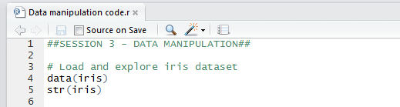
Iris dataset
Useful dataset with continuous variables and factors
Open new R script in Rstudio
Load iris data

Slide 5
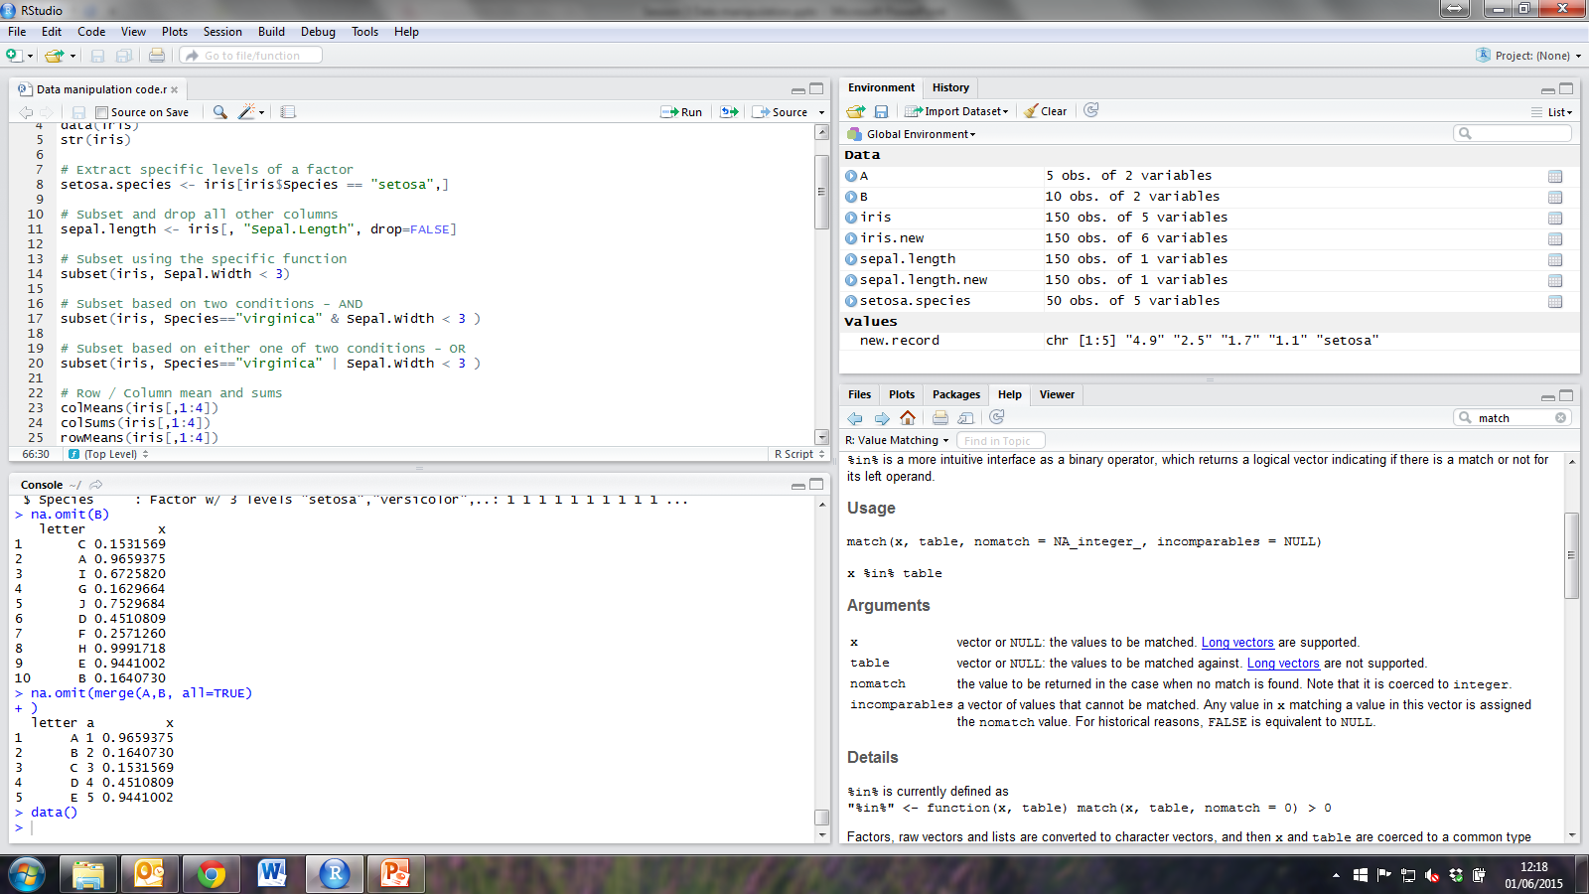
More subsetting!
In addition to the subsetting learnt last week, you can also:
Extract specific levels of a factor
Subset and drop the other columns from the data frame

Slide 6
subset() function
Alternative method to subset data:

Slide 7
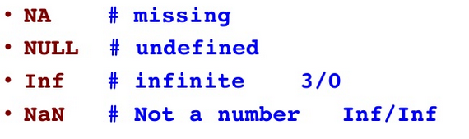
Useful syntax
Logical Operators
== | is equal to
!= | is not equal to
> | greater than
>= | greater than or equal to
< | less than
<= | less than or equal to
%in% | is in the list
! | not (reverses T & F)
& | and
| | or

Slide 8
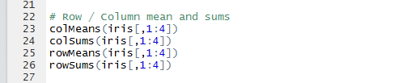
Row / Column mean and sums
You may want to quickly learn the sum or mean of columns or rows in your data frame:
NB. This cannot be performed for factors so a subset of the data frame is used.

Slide 9
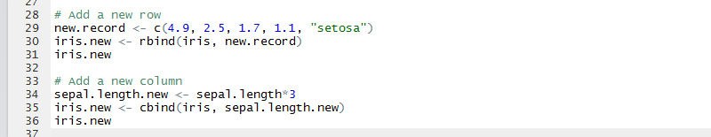
Adding new rows and columns
You may have a new record that you wish to add to your data frame, in which case use rbind,
OR you may have a new variable you would like to append, which can be done using cbind.

Slide 10
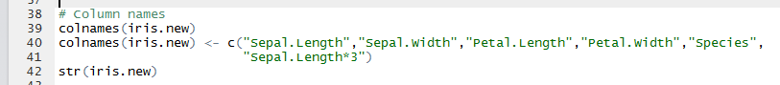
Column names
Column names can be viewed and amended
The same can also be done for row names.

Slide 11
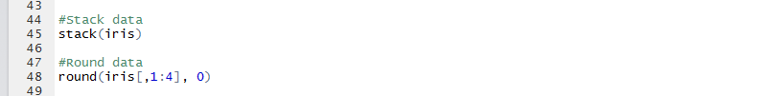
Stack and round data
“Stacking vectors concatenates multiple vectors into a single vector along with a factor indicating where each observation originated”
“Rounding rounds the values in its first argument to the specified number of decimal places (default 0)”

Slide 12
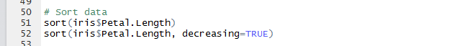
Sort data
Data frames can be sorted on particular variables
decreasing=TRUE can be used to reverse the sort

Slide 13
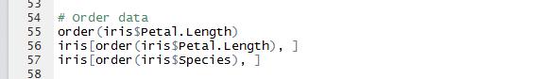
Order data
order() can be used to reorder the rows of a data frame according to the contents of one of its columns.
Subsetting brackets [] can be used to preserve the rest of the data frame.

Slide 14
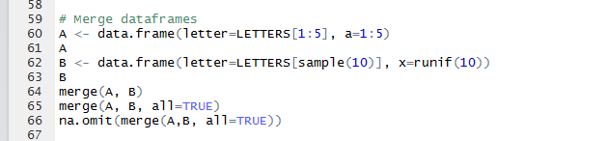
Merge data
“Merge two data frames by common columns or row names…”
Create two new data frames, A and B, to look at the merge() function.
na.omit() is also a useful function!

Slide 15
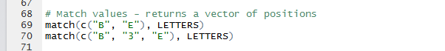
match() function
“Returns a vector of the positions of (first) matches of its first argument in its second”
LETTERS is a vector of constants pre-loaded in R.
NA is returned if there is no corresponding match.

Slide 16
Summary
Many different ways to manipulate data in R!
Not all covered here but the main functions, e.g. cbind, rbind, merge, subset and order should be sufficient for basic data manipulation.
There are many useful data manipulation packages available – most with easy to follow help pages

Slide 17
Some useful packages
dplyr – a ‘go to’ package for speedy data manipulation. Including shortcuts to subsetting, summarizing and rearranging data.
lubridate – Makes working with dates and times easier
tidyr – rearrange data so each column is a variable and each row an observation
reshape2 – transform data between wide and long formats (especially useful before plotting)

Slide 18
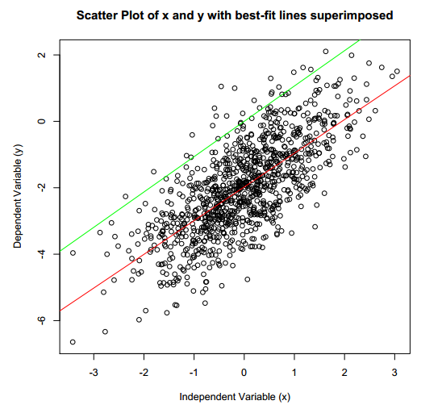
Next time...
Quick overview of:
ANOVAs
t-tests
Correlations
Regressions

Slide 19
ChallengeR
Use data() to explore all datasets available for use
Select one and run the following commands to practice your data manipulation:
subset()
rbind()
colMeans()
stack()
round()
order()
merge()

